Slide 1
Database Systems
Lecture 3-Chapter # 20
Introduction to Transaction Processing Concepts and Theory
Alina Arshad
alina.arshad@nu.edu.pk

Slide 2
Characterizing Schedules Based on Recoverability (cont’d.)
Cascadeless schedule
Avoids cascading rollback
Strict schedule
Transactions can neither read nor write an item X until the last transaction that wrote X has committed or aborted
Simpler recovery process
Restore the before image

Slide 3
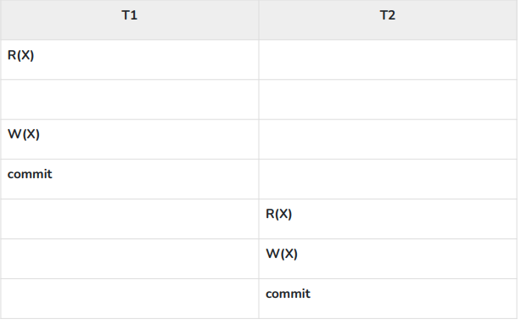

Slide 4
Characterizing Schedules Based on Serializability
Serializable schedules
Always considered to be correct when concurrent transactions are executing
Places simultaneous transactions in series
Transaction T₁ before T₂, or vice versa

Slide 5
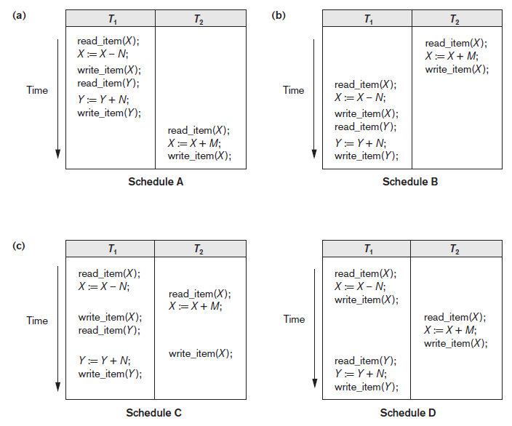
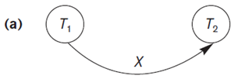
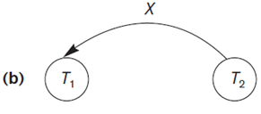
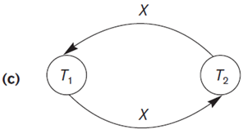
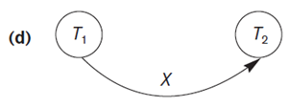
Figure 20.5 Examples of serial and nonserial schedules involving transactions T1 and T2 (a) Serial schedule A: T1 followed by T2 (b) Serial schedule B: T2 followed by T1 (c) Two nonserial schedules C and D with interleaving of operations

Slide 6
Characterizing Schedules Based on Serializability (cont’d.)
Problem with serial schedules
Limit concurrency by prohibiting interleaving of operations
Unacceptable in practice
Solution: determine which schedules are equivalent to a serial schedule and allow those to occur
Serializable schedule of n transactions
Equivalent to some serial schedule of same n transactions

Slide 7
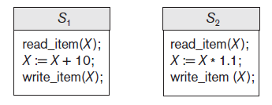
Characterizing Schedules Based on Serializability (cont’d.)
Result equivalent schedules
Produce the same final state of the database
May be accidental
Cannot be used alone to define equivalence of schedules
They execute different transactions
Figure 20.6 Two schedules that are result equivalent for the initial value of X = 100 but are not result equivalent in general

Slide 8
Characterizing Schedules Based on Serializability (cont’d.)
Conflict equivalence
Relative order of any two conflicting operations is the same in both schedules
Serializable schedules (Called conflict serializable)
Schedule S is serializable if it is conflict equivalent to some serial schedule S’.

Slide 9
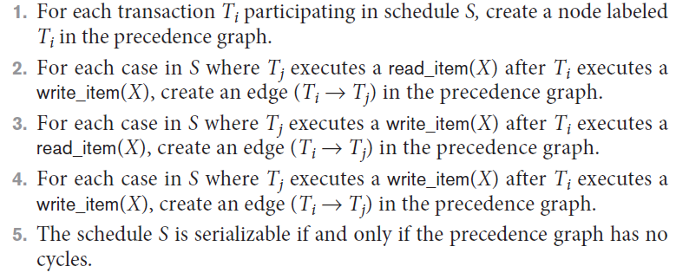
Characterizing Schedules Based on Serializability (cont’d.)
Testing for serializability of a schedule
Algorithm 20.1 Testing conflict serializability of a schedule S

Slide 10
Figure 20.7 Constructing the precedence graphs for schedules A to D from Figure 20.5 to test for conflict serializability (a) Precedence graph for serial schedule A (b) Precedence graph for serial schedule B (c) Precedence graph for schedule C (not serializable) (d) Precedence graph for schedule D (serializable, equivalent to schedule A)

Slide 11
How Serializability is Used for Concurrency Control
Being serializable is different from being serial
Serializable schedule gives benefit of concurrent execution
Without giving up any correctness
Difficult to test for serializability in practice
Factors such as system load, time of transaction submission, and process priority affect ordering of operations
DBMS enforces protocols
Set of rules to ensure serializability

Slide 12
View Equivalence and View Serializability
View equivalence of two schedules
As long as each read operation of a transaction reads the result of the same write operation in both schedules, the write operations of each transaction must produce the same results
Read operations said to see the same view in both schedules
View serializable schedule
View equivalent to a serial schedule

Slide 13
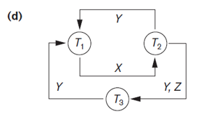
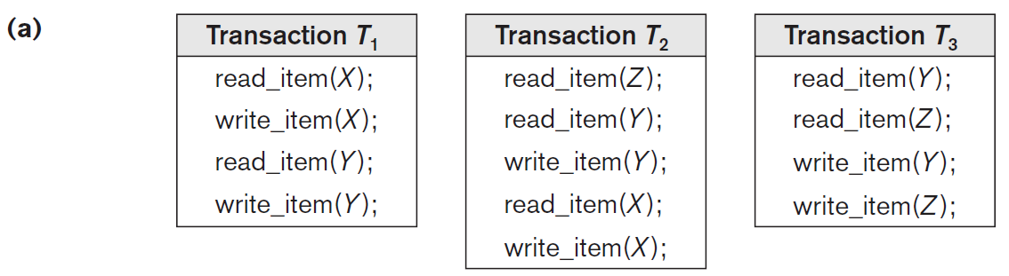
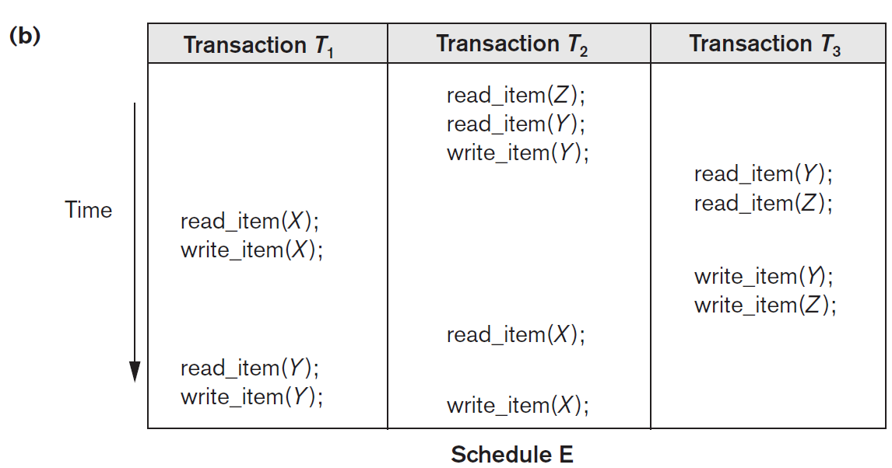

Slide 14
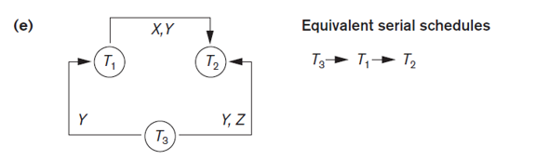
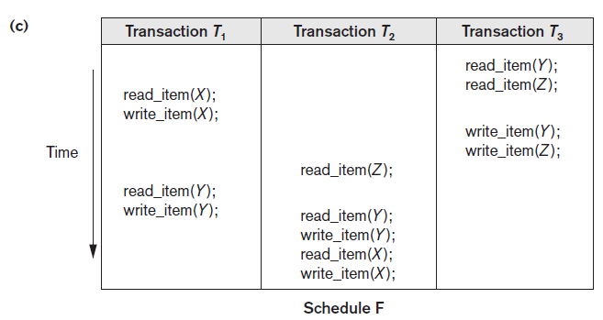

Slide 15
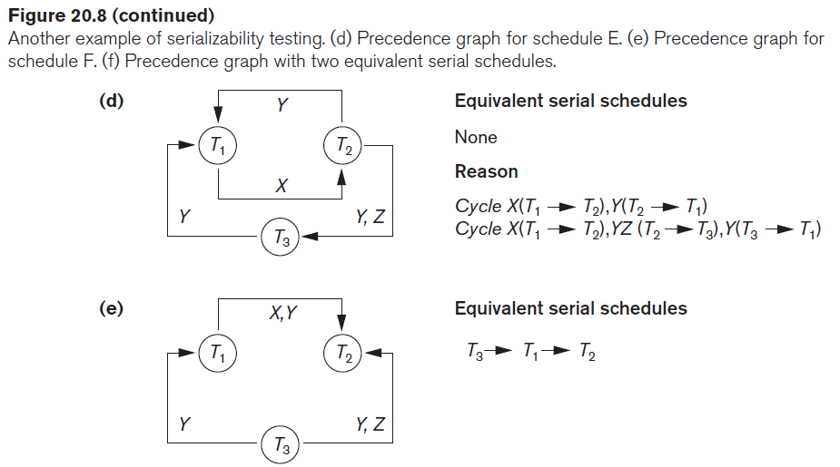
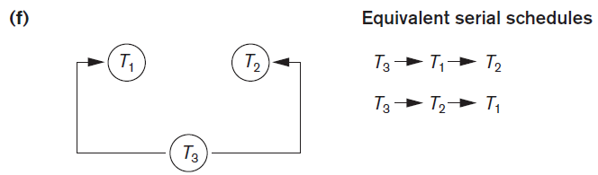

Slide 16
View Equivalent
Two schedules T1 and T2 are said to be view equivalent, if they satisfy all the following conditions:
1. Initial Read: Initial read of each data item in transactions must match in both schedules. For example, if transaction T1 reads a data item X before transaction T2 in schedule S1 then in schedule S2, T1 should read X before T2.
Read vs Initial Read: You may be confused by the term initial read. Here initial read means the first read operation on a data item, for example, a data item X can be read multiple times in a schedule but the first read operation on X is called the initial read.
2. Final Write: Final write operations on each data item must match in both the schedules. For example, a data item X is last written by Transaction T1 in schedule S1 then in S2, the last write operation on X should be performed by the transaction T1.
Update Read: If in schedule S1, the transaction T1 is reading a data item updated by T2 then in schedule S2, T1 should read the value after the write operation of T2 on same data item. For example, In schedule S1, T1 performs a read operation on X after the write operation on X by T2 then in S2, T1 should read the X after T2 performs write on X.

Slide 17
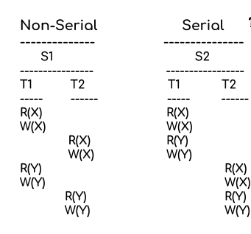
View Serializable schedule

Slide 18
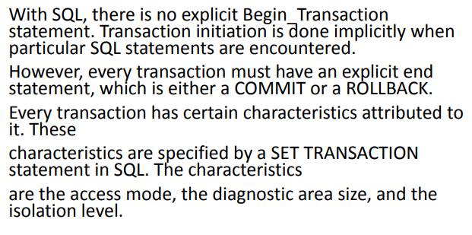
Transection support in SQL

Slide 19
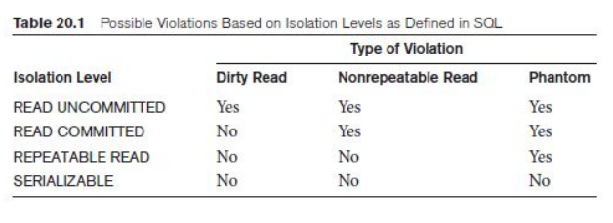

Slide 20
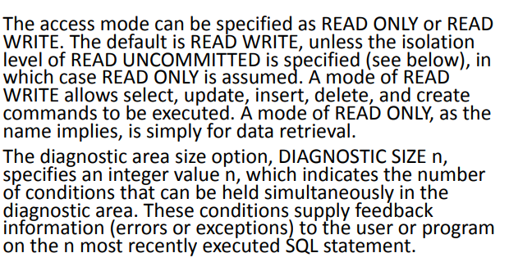

Slide 21
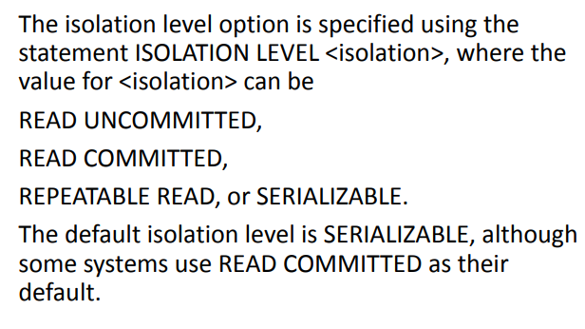

Slide 22
